Slide 1

Library Management System
Database Design
Presented by :
CH. VENKANNA BABU 25B11AI188
G . AVINASH 25B11AI374
M. VENKATA SWAMI 25B11AI656
CH . BHARGAV 25B11AI228
Under the Guidence :
Mrs . G L Narasamba Vanguri
Department : Artificial Intelligence & Machine Learning
A comprehensive relational database architecture for modern library operations — covering entities, schemas, relationships, and team workflow.

Slide 2


PROJECT OVERVIEW
Project Objectives
This project delivers a structured, scalable relational database system to power all core library operations — from inventory tracking to member management.
Scalable Architecture
Design a relational database that grows with library operations and user demand.
Scalable Schema
Inventory Management
Design relational models for growth
Manage books, copies, and locations
Unified Management
Centralize books, members, borrowing records, and inventory in one system.
Member & Loans
Real-time Availability
Track members and borrowing records
Enable live status and reservations
Real-Time Tracking
Enable live visibility into book availability and member account status.

Slide 3

CONTEXT
Problem Statement
⏱ Checkout Delays
📦 No Central Inventory
📋 Reporting Gaps
Manual processes slow down book checkouts and returns, creating frustrating bottlenecks for staff and members.
Without a centralized system, tracking book stock and member borrowing history is error-prone and inconsistent.
Overdue book management and operational reporting are difficult, inefficient, and largely manual today.
These pain points define the core requirements that drive our database design decisions.

Slide 4
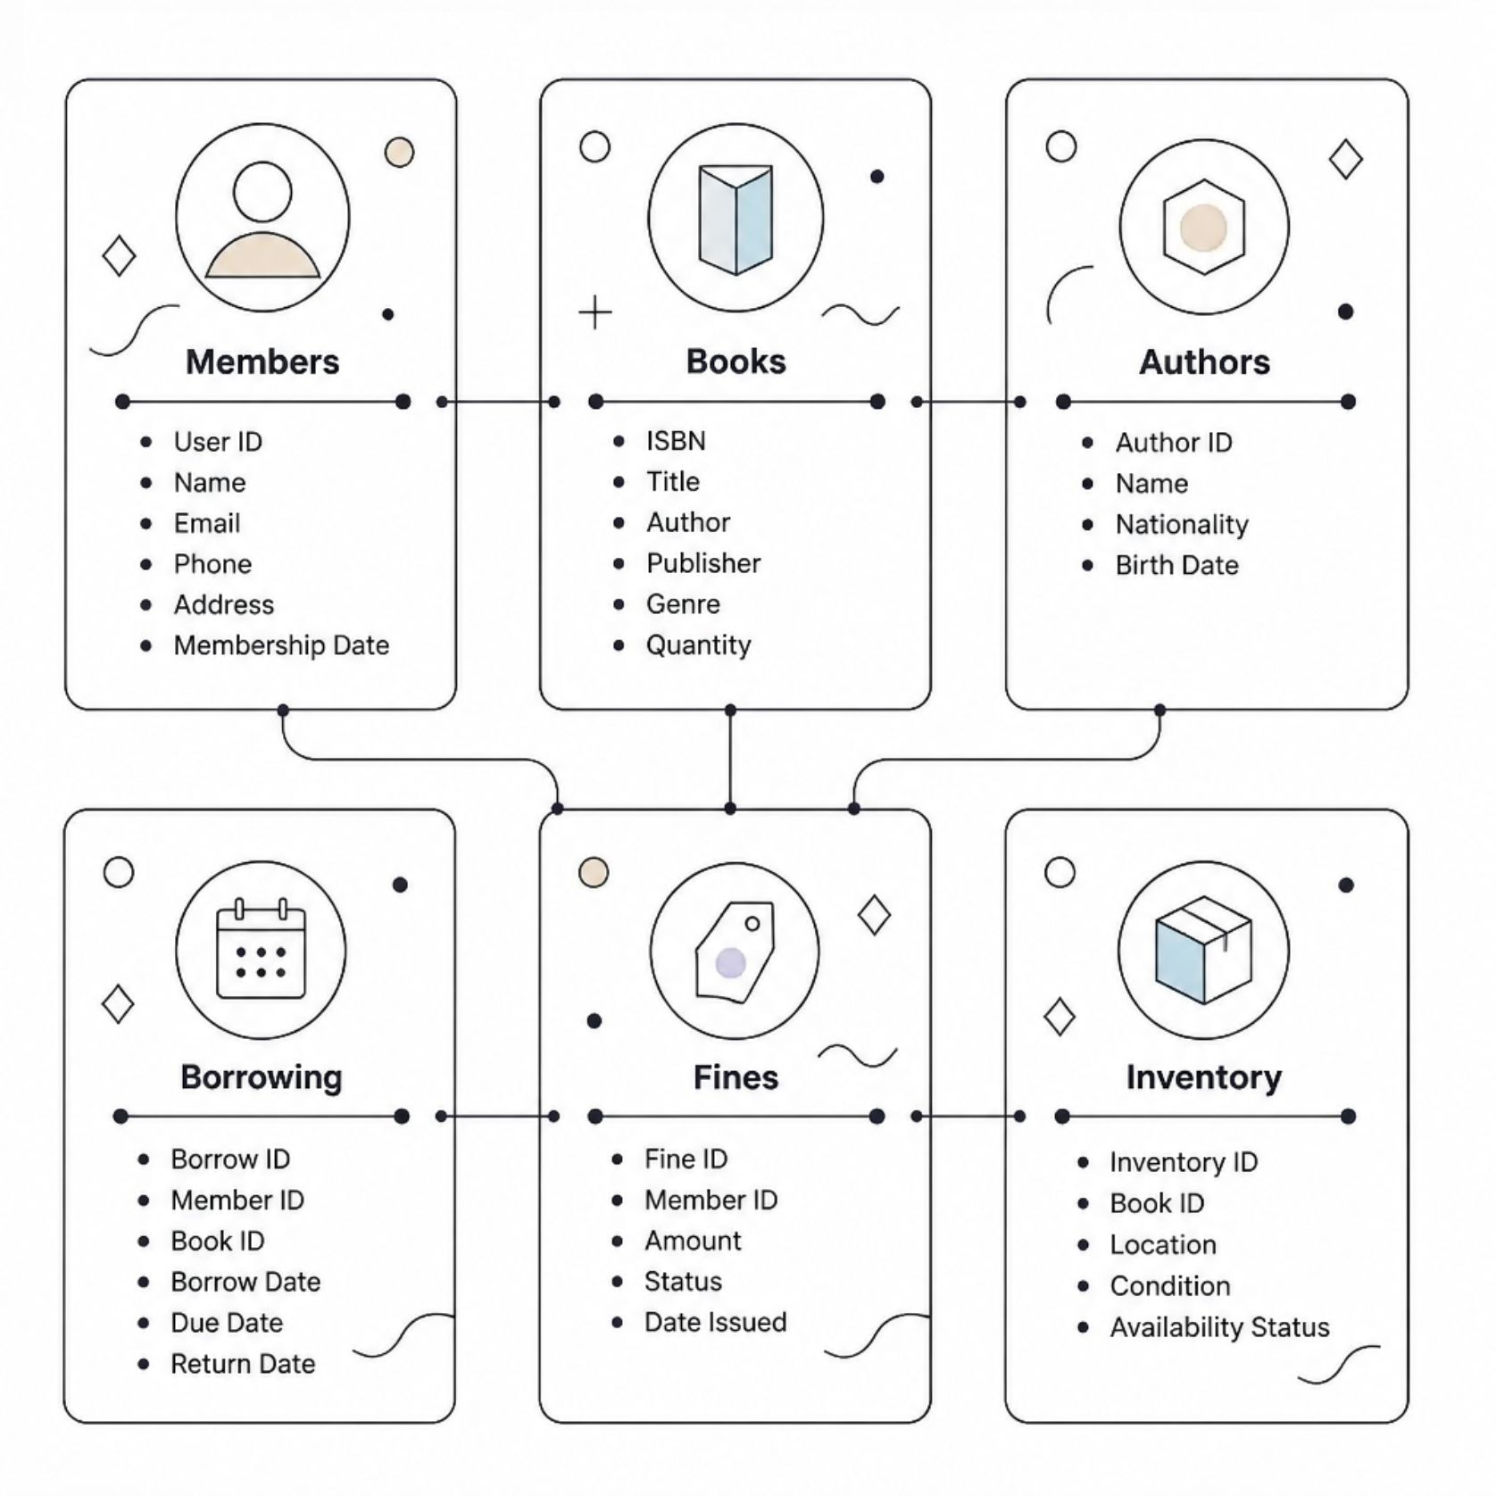
DATA MODELING
Six Key Entities
Core Entities Identified
The system is built around six well-defined entities, each capturing a distinct domain of library operations.
Members — User ID, Name, Email, Phone, Address, Membership Date
Books — ISBN, Title, Author, Publisher, Genre, Quantity
Authors — Author ID, Name, Nationality, Birth Date
Borrowing — Borrow ID, Member ID, Book ID, Dates
Fines — Fine ID, Member ID, Amount, Status, Date Issued
Inventory — Inventory ID, Book ID, Location, Condition, Status

Slide 5
DATA TYPES
Entity Attributes & Data Types
Entity
Key Attributes
Data Types
Members
ID, Name, Email, Phone, Membership Date
INT, VARCHAR, VARCHAR, CHAR, DATE
Books
ISBN, Title, Quantity, Genre
VARCHAR, VARCHAR, INT, ENUM
Borrowing
IDs, Borrow Date, Due Date, Return Date
INT, DATE, DATE, DATE
Fines
ID, Amount, Status, Date Issued
INT, INT, ENUM, DATE
Choosing precise data types ensures storage efficiency, query performance, and integrity enforcement at the database level.

Slide 6
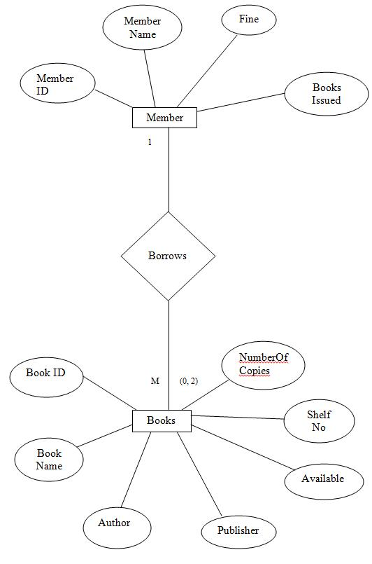
ER DIAGRAM
Entity Relationships
One-to-Many Relationships
Members --> Borrowing
one member can borrow multiple books over time
Books --> Borrowing
one book can be borrowed by multiple members
sequentially
Authors → Books
One author may write multiple books in the
catalog.
Books → Inventory
One book title can have multiple physical
copies tracked.

Slide 7




SCHEMA DESIGN
Relational Schema: Primary Tables
Members
Books
Authors
PK: member_id
PK: book_id
PK: author_id
name, email, phone
address, membership_date
isbn, title, genre
publisher, quantity
name, nationality
birth_date
These three primary tables form the core of the schema, holding master data that junction and detail tables reference via foreign keys.

Slide 8
SCHEMA DESIGN
Relational Schema: Junction & Detail Tables
Table
Primary Key
Foreign Keys
Key Attributes
Book_Authors
(book_id, author_id)
book_id, author_id
—
Borrowing
borrow_id
member_id, book_id
borrow_date, due_date, return_date
Fines
fine_id
member_id
amount, status, date_issued
Book_Authors is a junction table resolving the many-to-many relationship between books and authors using a composite primary key.

Slide 9
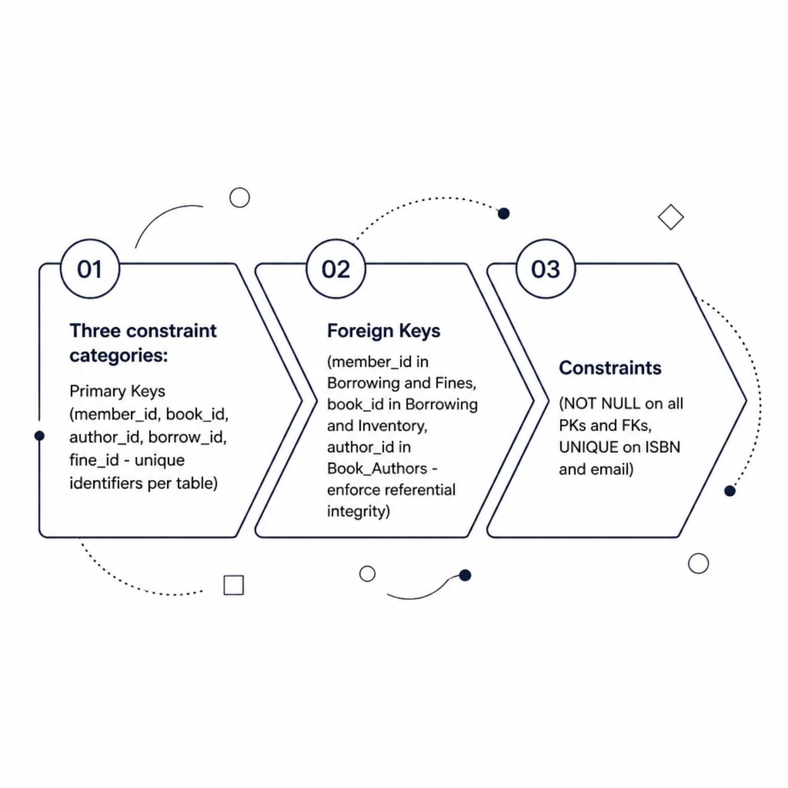

INTEGRITY
Primary & Foreign Keys
Constraint Strategy
Primary Keys
Foreign Keys
Unique identifiers per table: member_id, book_id, author_id, borrow_id, fine_id
member_id in Borrowing/Fines · book_id in Borrowing/Inventory · author_id in Book_Authors
Constraints
NOT NULL on all PKs and FKs · UNIQUE enforced on ISBN and email fields

Slide 10



NORMALIZATION
Database Normalization
3NF — Third Normal Form
2NF — Second Normal Form
No transitive dependencies. Every attribute depends directly on the primary key, not on other non-key attributes.
1NF — First Normal Form
All non-key attributes depend on the entire primary key — partial dependencies eliminated.
Atomic values only. No repeating groups or multi-valued attributes exist in any table.
Achieving 3NF minimizes redundancy, prevents update anomalies, and ensures long-term data integrity across all tables.

Slide 11
VERSION CONTROL
GitHub Repository Setup
Repository Structure
Workflow & Documentation
main branch — stable, production-ready code only
develop branch — active feature development and integration
README — project overview, database design summary, and setup instructions
Design Doc — full schema, ER diagram references, normalization notes
/docs
/sql
ER diagrams and schema documentation
DDL scripts for table creation and seeding
/src
Application source code
All DDL changes must go through pull requests and peer review before merging to main.

Slide 12
CONCLUSION
The Library Management System provides a structured and scalable database for efficient library operations.
The design improves data integrity, reduces redundancy, and supports effective management of books, members, and borrowing records.
THANK YOU

